Slide 1
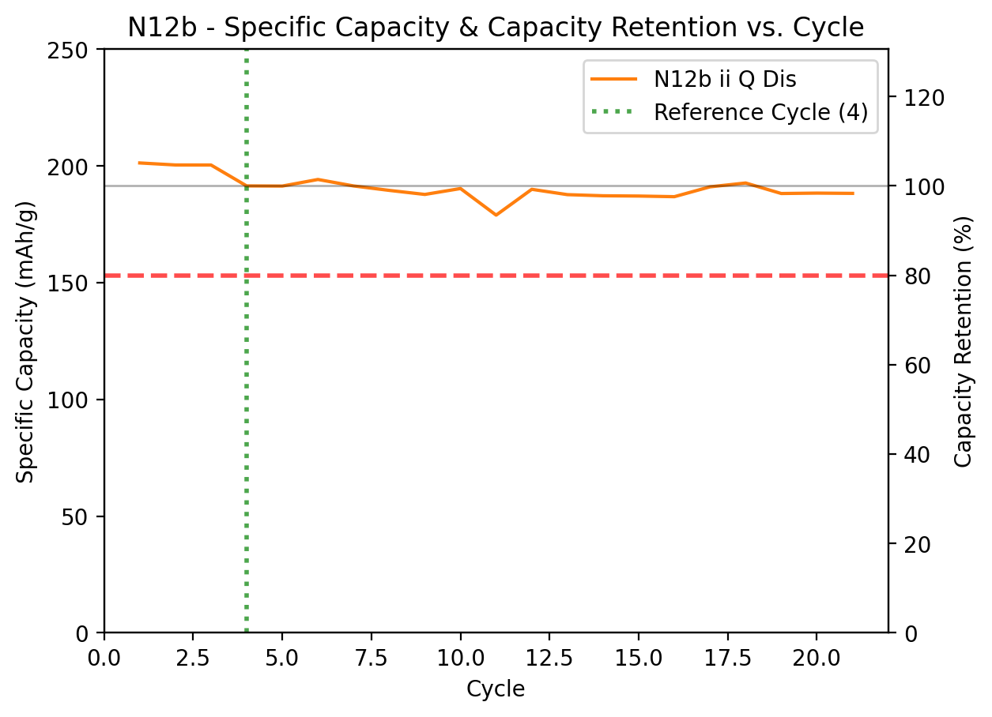
Project: NMC Cathode – EXP ID: N12b CHEMISTRY: NMC811(Half) | KEY VARIABLES: NMC, EL, Loading
SPECIFICATIONS & PROTOCOL:
1. Cell & Electrode Metadata
Cathode: NMC811(BASF):PVDF:Hx-e(HCl-AW)| 94:3:3
Loading: 7.61mg/cm² (total); 49µm thick
Current Collector: Al)
Electrolyte: 1M LiPF₆ 1:1:1, 5% FEC, 2% VC
E/C Ratio: 60µL total (4.41µL/mg_{active})
Separator: CC, 2+12+2µm
2. Testing Protocol
Voltage Window: 3.0-4.2V vs. Li/Li⁺
Formation: 3 cycles @ C/20
Cycling Rate: C/8 Charge (CC-CV), C/8 Discharge (CC)
3. Conclusion
Active material successfully increased
Capacity could be pushed with higher cutoff voltages, assuming anode compatibility
Continue testing in full cells with leading anodes
KEY RESULTS
Metric | Benchmark | Value | Score
1st Discharge Cap. (mAh/g) | >200 | 201.3
Reversible Capacity (mAh/g) | >180 | 191.4
Areal Cap. (mAh/cm²) | N/A | 1.45
FCE (%) | >95 | 90.14%
Capacity Retention(%) | >95 | 98.3% @ Cyc 20
Avg. Post-Form. CE (%) | >99.9 | 99.933%

